Slide 1

Telco Customer Churn Prediction
Predicting customer retention using machine learning and Streamlit
Team Members:
Ali Mohamed – Data PreprocessingMahmoud Merdien – Data PreprocessingOmar Tokal – Feature Engineering
Yahia Mohamed – Model Selection & ValidationAhmed Mohamed – Model Selection & ValidationKhaled Abdelazim – Deployment (Streamlit)
Notes:
1

Slide 2
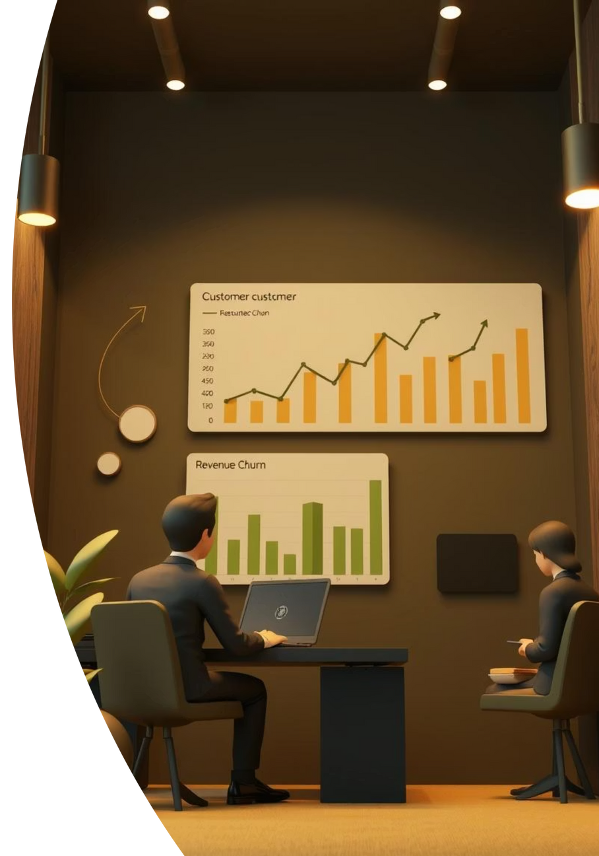



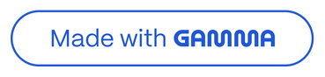
Introduction & Problem Statement
Defining Churn
Why it Matters
Churn refers to when a customer discontinues their service with a provider. In the telecom industry, this means a subscriber opting out of their contract.
Customer churn directly impacts revenue and growth. Acquiring new customers is often more expensive than retaining existing ones, making churn prediction critical.
Our Objective
Develop a machine learning model to accurately predict which customers are likely to churn, enabling proactive retention strategies for telecom companies.
Notes:
2

Slide 3
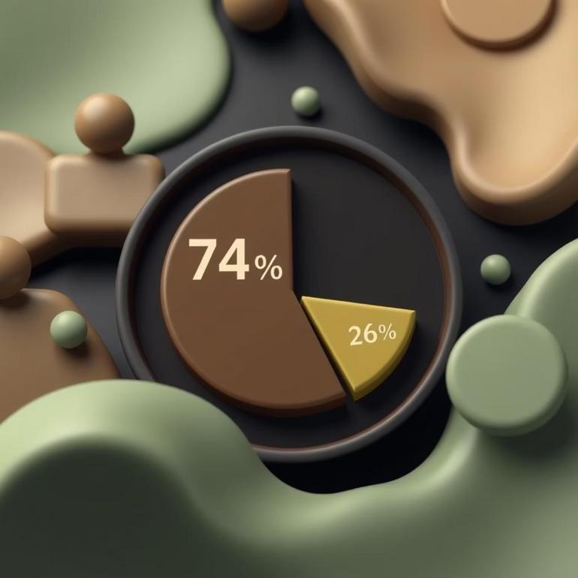
Dataset Overview: Telco Customer Churn
Source: Publicly available Telco Customer Churn Dataset.
Size: Approximately 7,043 rows representing individual customer records and 21 columns detailing various attributes.
Target Variable: 'Churn' (Yes/No), indicating whether a customer has left the service.
Class Imbalance: A significant challenge, with ~26% of customers having churned versus 74% retained.
Data Types: A mix of demographic information, contract details, billing specifics, and service usage patterns.
Understanding the dataset is crucial for building a robust and reliable prediction model.
Notes:
3

Slide 4


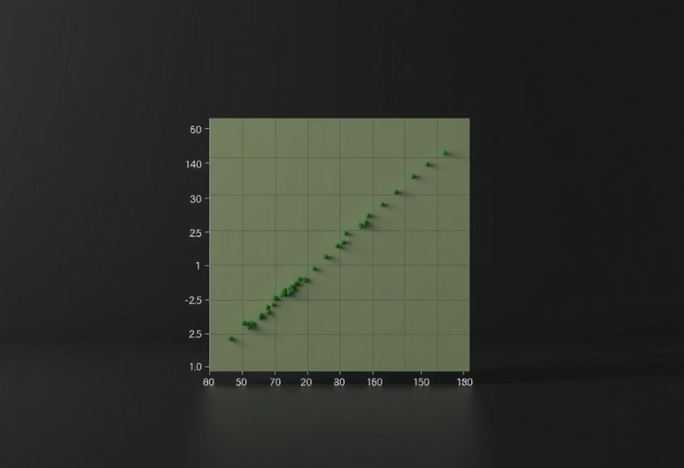


Data Preprocessing Pipeline
👤 Ali Mohamed & Mahmoud Merdien
Missing Values
Categorical Encoding
Outlier Removal
Addressed incomplete data points using imputation techniques to ensure data integrity.
Converted non-numeric categorical variables into a numerical format suitable for machine learning algorithms.
Identified and managed extreme data points that could negatively impact model performance.
Feature Scaling
Train/Test Split
Normalized numerical features to a standard range, preventing dominance by variables with larger magnitudes.
Divided the dataset into training and testing sets to evaluate the model's generalization capability.
Notes:
4

Slide 5

Feature Engineering & Selection
👤 Omar Tokal
Dummy Variable Creation
Transformed categorical features into a format that ML models can process, enhancing predictive power.
Feature Selection Techniques
Employed methods like Recursive Feature Elimination to identify the most relevant features and reduce dimensionality.
Correlation Analysis
Examined relationships between variables to understand their impact on churn and identify potential multicollinearity.
Improving Interpretability
Focused on creating features that not only boost performance but also offer clearer insights into churn drivers.
Notes:
5

Slide 6
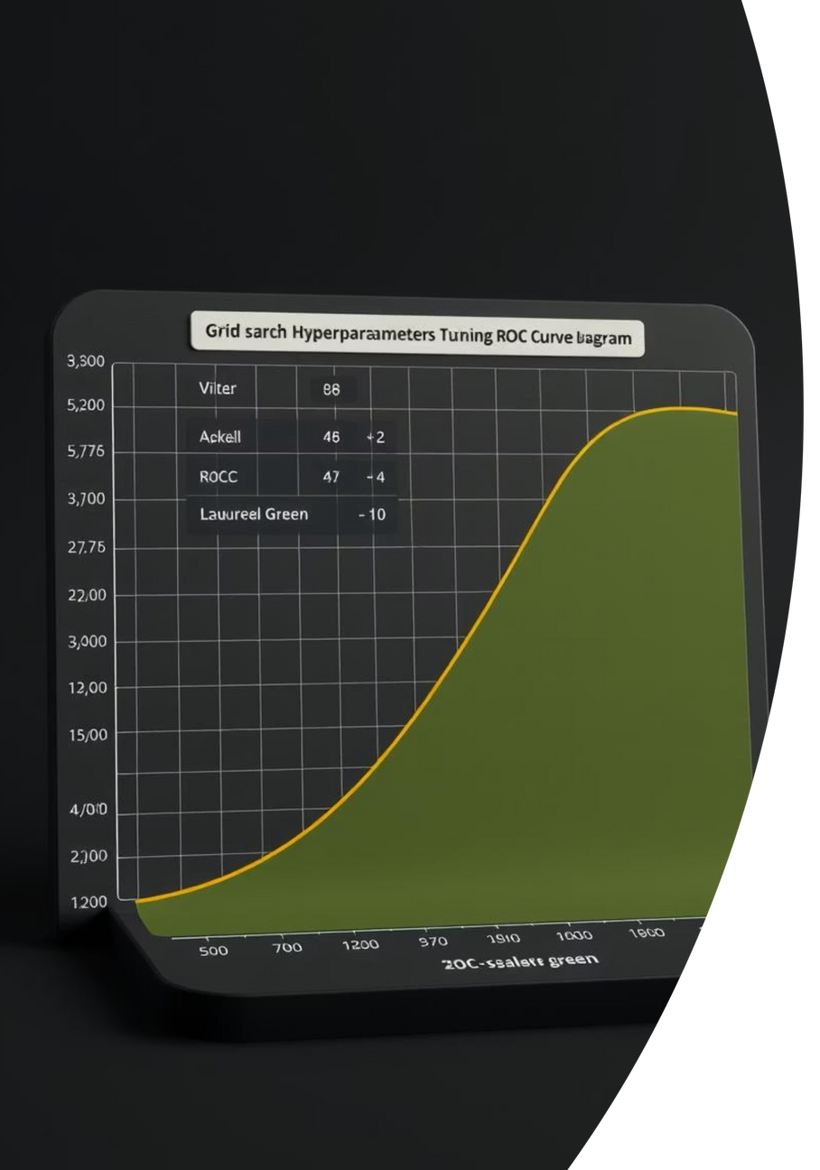
Model Selection & Validation
👤 Yahia Mohamed & Ahmed Mohamed
Algorithms Tested
Key Techniques
Logistic Regression
SMOTE: Synthetic Minority Over-sampling Technique to address class imbalance.
Random Forest
K-Nearest Neighbors (KNN)
Decision Tree
GridSearchCV: Exhaustive search for optimal hyperparameters across algorithms.
Support Vector Machine (SVM) ✅ (Final Choice)
Gradient Boosting
Evaluation Metrics
XGBoost
Accuracy, Precision, Recall, F1-score
ROC-AUC (Receiver Operating Characteristic - Area Under Curve)
Notes:
6

Slide 7

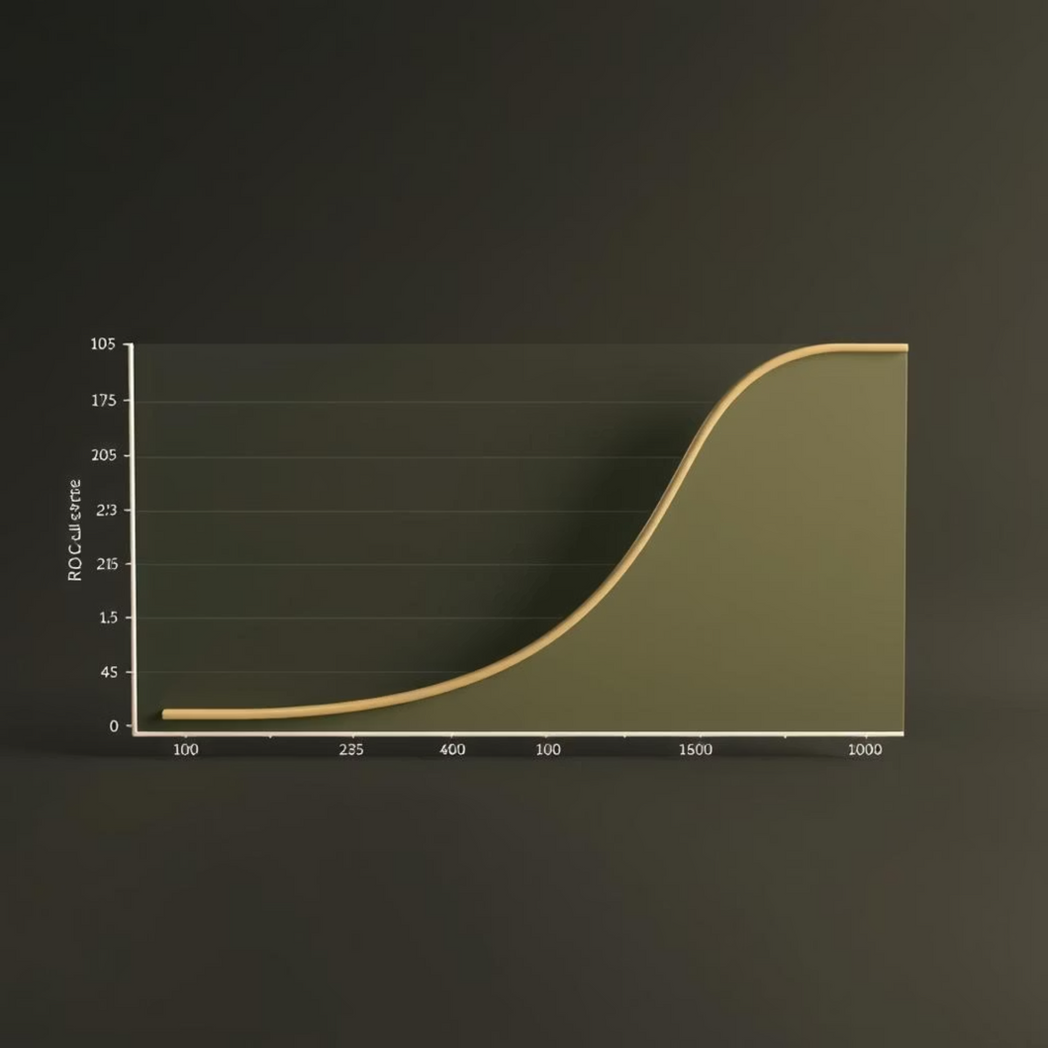
Model Performance & Results
Our rigorous testing led us to select the Support Vector Classifier (SVC) as the optimal model.
SVC (final)
0.82
0.64
0.57
0.60
0.85
Random Forest
0.81
0.61
0.54
0.57
0.84
Logistic Regression
0.82
0.61
0.57
0.59
0.85
The SVC model demonstrated superior balance across key metrics, making it the most reliable choice for predicting churn.
Notes:
7

Slide 8
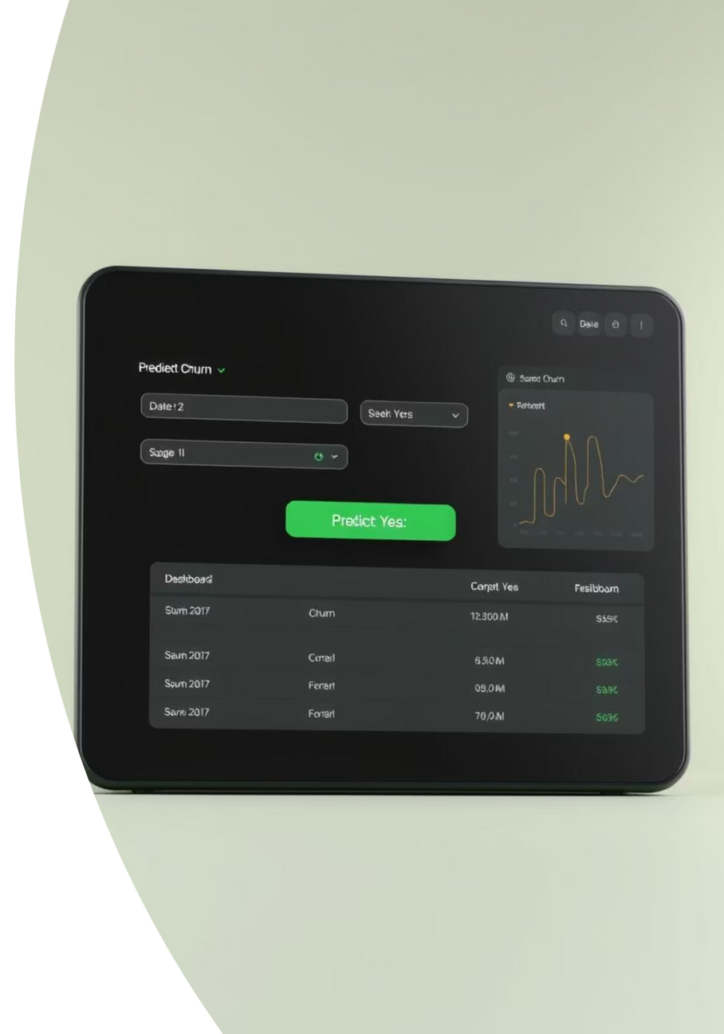
Deployment with Streamlit
👤 Khaled Abdelazim
Interactive Web App
Real-time Prediction
Developed a user-friendly Streamlit application, transforming our ML model into an accessible tool.
Users can input various customer data points and receive instant churn predictions (Yes/No).
Bridging the Gap
Streamlit allows non-technical stakeholders to interact with the model, seeing its value firsthand.
This deployment showcases the practical application of our machine learning solution, delivering actionable insights.
Notes:
8

Slide 9


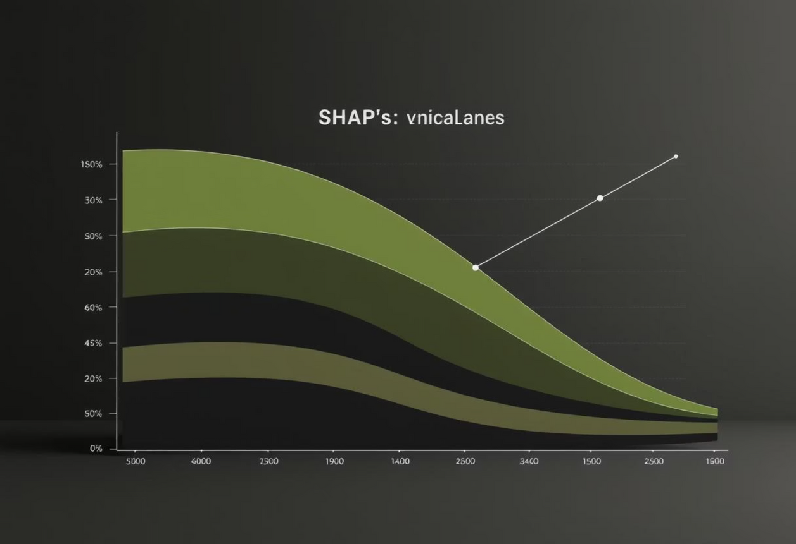
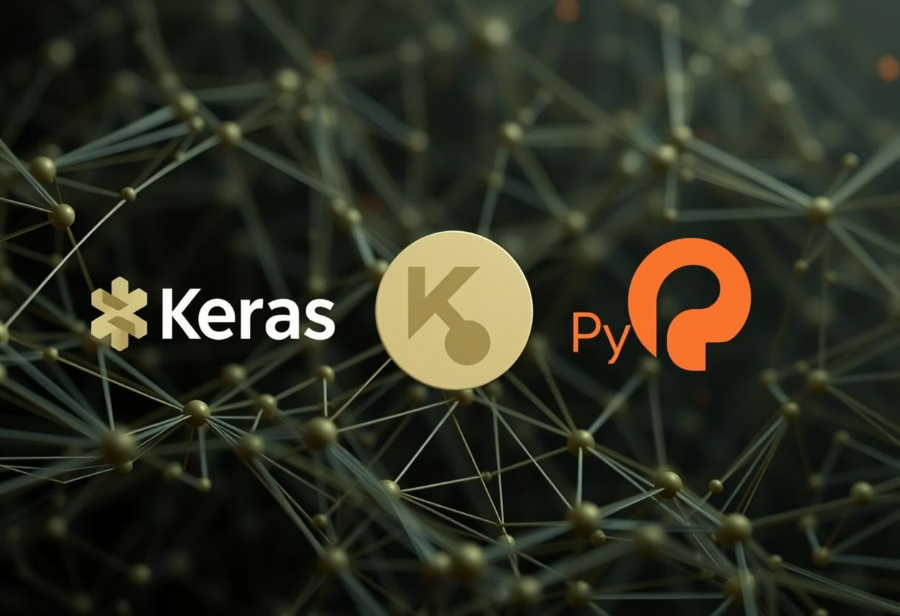
Future Work & Enhancements
Cloud Deployment
Migrate the Streamlit application to platforms like Streamlit Cloud or Hugging Face Spaces for broader accessibility and scalability.
Explainable AI (XAI)
Integrate SHAP (SHapley Additive exPlanations) or LIME (Local Interpretable Model-agnostic Explanations) to provide insights into model decisions.
Deep Learning Exploration
Experiment with advanced neural network architectures using frameworks like Keras or PyTorch for potential performance gains.
Notes:
9

Slide 10








Conclusion & Impact
Real-World Value
End-to-End Project
Our model empowers telecom companies to proactively identify at-risk customers, fostering retention and boosting revenue.
Successfully navigated the entire ML pipeline, from raw data processing to a functional deployed model.
Skill Demonstration
Collaborative Success
Showcased comprehensive expertise in data science, machine learning, and practical application development.
A testament to effective teamwork and specialized contributions from each team member.
Thank you for your attention.
Notes:
10

